Slide 1
CompTIA Security+ Study Guide (SY0-501)
Chapter 2:
Monitoring and Diagnosing Networks

Slide 2
Chapter 2: Monitoring and Diagnosing Networks
Explain use cases and purpose for frameworks, best practices, and secure configuration guides
Given a scenario, implement secure network architecture concepts
Given a scenario, implement secure systems design
Explain the importance of secure staging
Deployment concepts

Slide 3
Framework
An Abstraction (Large Collection)
  Software that Provides Generic Functionality
  That is Selectively Changed by Additional user-written Code
  Thus Providing Application-specific Software that can have its “Behavior” altered
    (by the Presence of some Additional Text)

Slide 4
Frameworks, Best Practices, and Configuration Guides
ISO Standards
North American Electric Reliability Corporation (NERC)
National Institute of Standards and Technology (NIST)
ISA/IEC-62443
  Series of Standards, Technical Reports, and Related Information that define Procedures for implementing electronically secure Industrial Automation and Control Systems (IACS)
Payment Card Industry Data Security Standard (PCI-DSS)
OWASP (Open-Web-App. Security Project)
SEI (sei.cmu.edu)

Slide 5
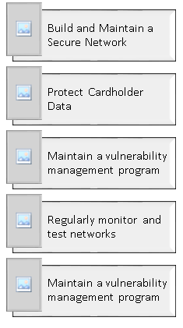
Payment Card Industry Data Security Standard (PCI-DSS)

Slide 6
Open Web Application Security Project (OWASP)
1. Verify for Security Early and Often
2. Parameterize Queries
3. Encode Data
4. Validate All Inputs
5. Implement Identity and Authentication Controls
6. Implement appropriate Access Controls
7. Protect Data
8. Implement Logging and Intrusion Detection
9. Leverage Security Frameworks and Libraries
10. Error and Exception Handling

Slide 7
11 Biggest Threats to Online Security
Malware:
  Virus
  Adware
  Spyware
  Ransonware
  Trojan Horses
  Worms
Phishing:
  Spear
  Whale
  Vishing
Pharming:
  Large scale Phishing Ruse
    DNS Cache / Server Poisoning

Slide 8
11 Biggest Threats to Online Security
Application Vulnerabilities
  Most common problem: Improper Input Data Validation!
Dos / DDoS
Scams
Rootkits
SQL, Shell (OS), NoSQL, Script, LDAP Injection
MITM
Spamming
Wireless (or otherwise) Eavesdropping

Slide 9
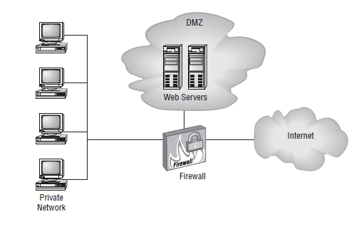
Secure Network Architecture Concepts
Zones {RVW. “BigStack”}
  Compartmentalize our Network Segments / VLANs
    Intranet (for example, the LMI)
Demilitarized zone (DMZ)
Extranet
Internet (Full, Public Network, Unsecured)
Wireless

Slide 10
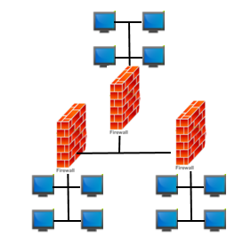
Network Segmentation
Physical - Wiring
Logical – L3 Subnetting
Virtual – Electronically
(Switches)

Slide 11
Honeypots and Honeynets
Honeypot: An Additional separate System that appears to be an Attractive Target but is in reality A Trap For Attackers
Honeynet: A Fake Network Segment that appears to be a very enticing target (a logical extension of a honeypot)
  Sometimes called “Jail Network”

Slide 12
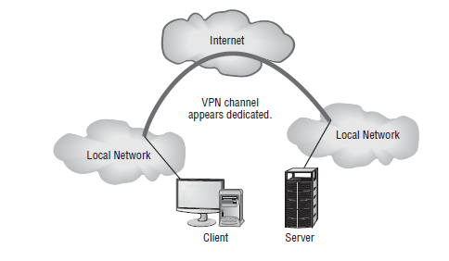
Tunneling/VPN

Slide 13
Tunnel…
Technique using both:
  Existing (Public) Protocols
  Standardized Additional Protocols for additional, Superior Security
For:
  Private Data Communication
  Over Public Networks
    Using Standard Public Carrier Protocols
      L2::Ethernet or PPP
      L3::IP
      L4::TCP or UDP

Slide 14
Tunnel…
Technique:
  First “Encapsulate” the Payload, as per normal
    L2 and L3 (minimally)
  Then “Insulate” / “Encapsulate” the Payload
    As it travels on the Public Network using Public (well known, well-attacked) Protocols
  Next, Wrap your Private IP “Packet” inside of
    Yet-Another Publicly-Routable IP “Packet”
      the Outer / Public being the “Carrier” Packet
        Analogue – Put your Private Letter inside an Envelope (Public Carrier for the letter)
  Finally, Encrypt the Private / Inner / Payload Packet/s
NOTE – starts Encryption from (commonly) L2 (If Use EAP) all the way up the remainder of the Network Stack
{{{ Correlate to BigStack }}}}

Slide 15
Security Devices
Firewalls {Corr. To BigStack}
  Proto Filtering FW ([L2 &] L3)
  Port Filtering (L4)
  Proxy FW (L5 [and above])
  Stateful FW ([L2 –] L7 [& Beyond])
  Next Gen FW (All Layers & Beyond)
Software-defined networking (SDN)
  {BigStack Diagram}
    Note – slowly starting to implement various degrees of SDN-Capability in Clouds
IDS/IPS

Slide 16
Secure Systems Design
Hardware and Firmware
  UEFI
    Unified Extensible Firmware Interface
    {FYI – “Flash” versus “Phlash”}
  BIOS {Old Term-Replaced by “UEFI” or “Firmware”}
Operating Systems Software:
  (Internal Fx() Components – Managers)
  Drivers
  Services
  Applications
Peripherals
  {follow Mfg. Recommendations/BP}

